Slide 1

Supervised Learning
경희대학교 컴퓨터공학과
2019102191 신주영

Slide 2
Table of contents
Linear Regression
Regularization
Logistic Regression
SVM (Support Vector Machine)
SVM using kernel
Naïve Bayes Classification
Random Forest
Neural Network

Slide 3
Supervised Learning
Linear Regression
경희대학교 컴퓨터공학과
2019102191 신주영

Slide 4
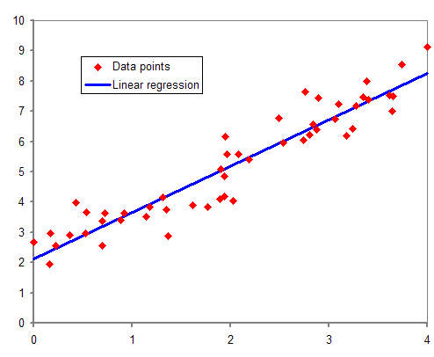
Fundamental concept
A technique for modeling relationships in which dependent variables change large or small as independent variables grow
y = ax + b, a is called the inclination and b is called the y-intercept

Slide 5
Algorithm
Usually, in linear regression, the learning parameters a and b of the data points that are not on a straight line must be calculated
Create a straight line to minimize the mean square error
Mean square error formula
$$\sum_{i=1}^{n}{\frac{y_{i}−{\left(a+bx_{i}\right)}^{2}}{n}}$$

Slide 6
Algorithm
A function that defines the relationship between error and learning parameters is called a loss function.
Linear regression finds a parameter with a minimum loss function value among various straight lines.
Finding parameters that minimize loss function values is also a concept commonly used in guidance learning algorithms.

Slide 7
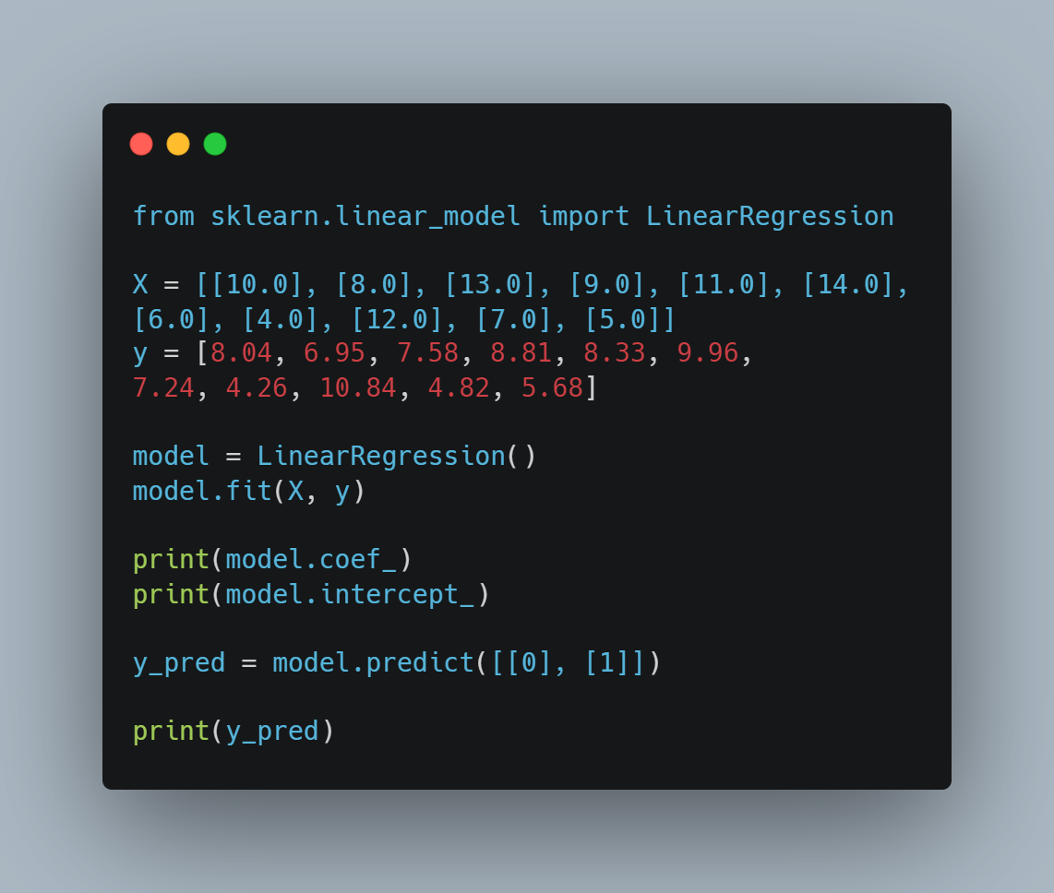
Sample code
From sklearn, import Linear Regression
Set X, y variable
Make Linear Regression variable
Fit X, y to Linear Regression model
Print inclination and y-intercept
Predict y-values when x is 0 and 1 with the predict method

Slide 8

Output
We can get inclination by model.coef_ method
We can get y-intercept by model.intercept_ method
We can get y-values when x is 0 and 1 by model.predict method

Slide 9
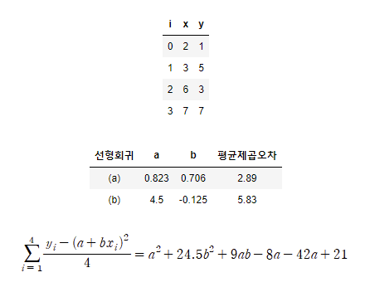
Method of minimizing mean square error
Let x and y as shown on the right.
The table below shows the average square error values according to the values a and b.
Substituting the x and y values into the mean square error formula, the following equation can be obtained.
Therefore, the minimum value of the equation according to the values a and b may be obtained.

Slide 10
Type of linear regression
Since polynomial regression is not linear, it may be awkward to call it linear regression, but because it is linear regression for learning parameters rather than independent variables, polynomial regression is also included in linear regression.
선형회귀의 종류 | 함수 정의 예
단순선형회귀 Simple linear regression | y = ax + b
다중선형회귀 multiple linear regression | z = ax + by + c
다항회귀 Polynomial regression | y = ax^2 + bx + c

Slide 11
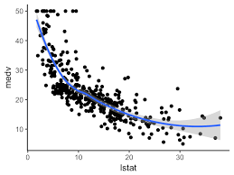
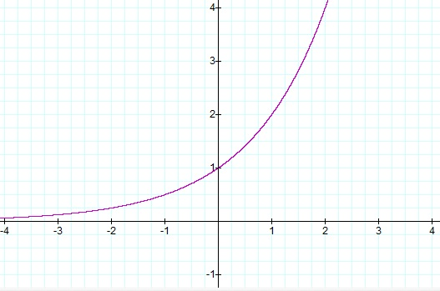
Nonlinear regression
y = e^x
y = 1/x

Slide 12
Supervised Learning
Regularization
경희대학교 컴퓨터공학과
2019102191 신주영

Slide 13
Fundamental concept
Normalization is used as a way to prevent over-fitting of the model
In over-fitting, the error between the execution result and the correct answer data is very small, but the error between the result of executing the model with test data and the correct answer data is very large

Slide 14
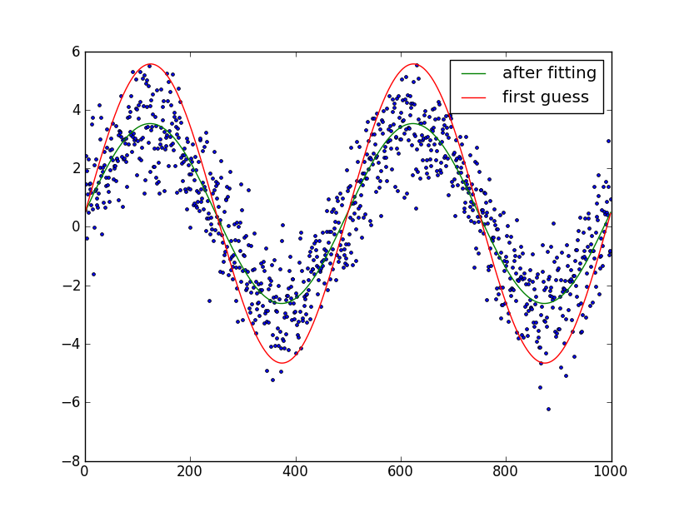
Fundamental concept making practice data
We created data by adding random numbers to the function $y=\sin\left(2πχ\right)$
We’ll apply linear regression to this data to make it a machine learning model
When the order is increased, we’ll check how the learning error and test error change

Slide 15
Learning errors and test errors by order
As the order increases, the learning error gradually decreases
The test error increases as the order increases
The sixth-order linear regression is a complex model, so learning errors are reduced, but over-fitting occurs and cannot be called a generalized model.
차수 | 학습오차 | 검정오차
1 | 0.412 | 0.618
2 | 0.176 | 0.193
3 | 0.081 | 0.492
… | … | …
6 | 0.024 | 3.472

Slide 16
Consequences of using normalization for linear regression
Normalization prevents over-fitting by adding a penalty term to the loss function
When the order increased, the test error did not increase, so that over-fitting could be prevented
We’re going to regularization method as a ridge regression
차수 | 학습오차 | 검정오차
1 | 0.412 | 0.612
2 | 0.372 | 0.532
3 | 0.301 | 0.394
… | … | …
6 | 0.159 | 0.331

Slide 17
Algorithm only linear regression
As the order increases, the absolute value of the learning parameter gradually increases.
차수 | $$w_{1}$$ | $$w_{2}$$ | $$w_{3}$$ | $$w_{4}$$ | $$w_{5}$$ | $$w_{6}$$
1 | -0.007 | -0.217 | - | - | - | -
2 | 0.978 | -5.222 | 4.204 | - | - | -
3 | 0.281 | 4.927 | -17.639 | 12.157 | - | -
… | … | … | … | … | … | …
6 | 1.080 | -26.324 | 287.431 | -1034. 141 | -1611. 144 | -1147. 946

Slide 18
Algorithm linear regression with normalization
Normalization reduces the increase in learning parameters.
차수 | $$w_{1}$$ | $$w_{2}$$ | $$w_{3}$$ | $$w_{4}$$ | $$w_{5}$$ | $$w_{6}$$
1 | -0.055 | -0.149 | - | - | - | -
2 | -0.066 | -0.493 | 0.421 | - | - | -
3 | -0.001 | -0.716 | -0.042 | 0.670 | - | -
… | … | … | … | … | … | …
6 | 0.191 | -0.751 | -0.497 | -0.182 | 0.109 | 0.370

Slide 19
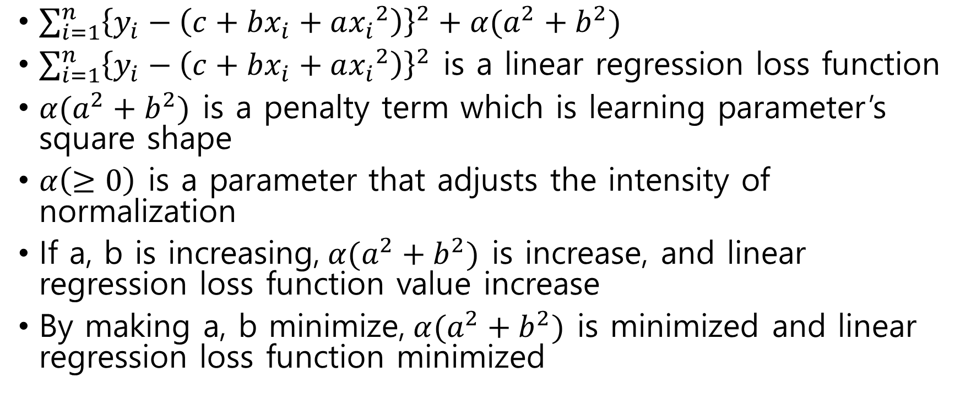
Algorithm loss function and penalty term
$\sum_{i=1}^{n}{{\left\{y_{i}−\left(c+bx_{i}+a{x_{i}}^{2}\right)\right\}}^{2}}+α(a^{2}+b^{2})$
$\sum_{i=1}^{n}{{\left\{y_{i}−\left(c+bx_{i}+a{x_{i}}^{2}\right)\right\}}^{2}}$ is a linear regression loss function
$α(a^{2}+b^{2})$ is a penalty term which is learning parameter’s square shape
$α\left(≥0\right)$ is a parameter that adjusts the intensity of normalization
If a, b is increasing,$α(a^{2}+b^{2})$ is increase, and linear regression loss function value increase
By making a, b minimize,$α(a^{2}+b^{2})$ is minimized and linear regression loss function minimized

Slide 20
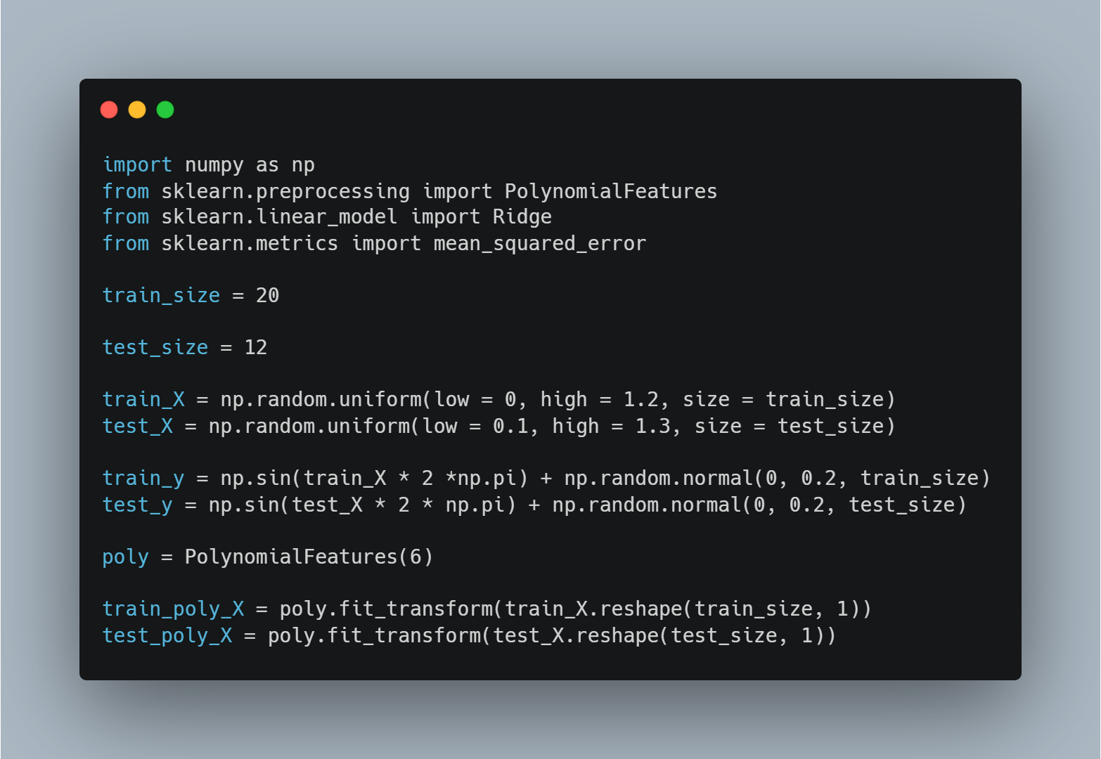
Sample code
Import numpy, PolynomialFeatures, Ridge, mean_squared_error
Set training data and test data
Construct a six-order linear regression model
Conversion of the results into an array after learning the characteristics of the learning data in the sixth equation

Slide 21
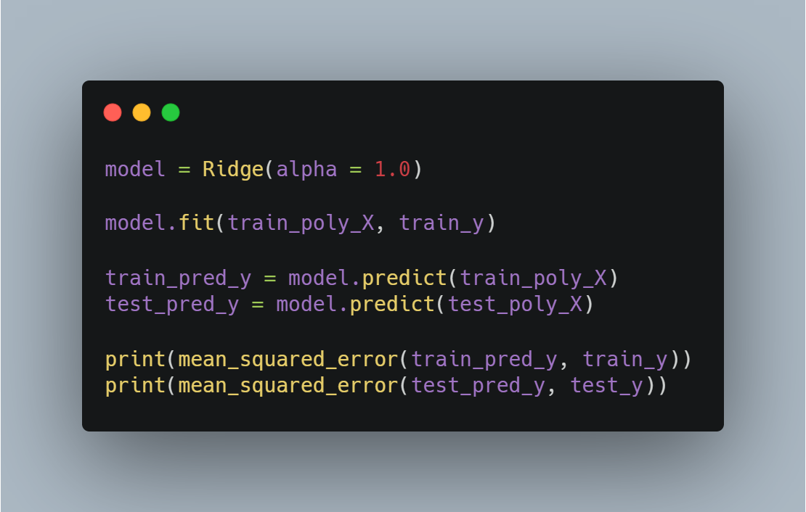
Sample code
Make ridge model and learn as a dependent variable of 6th-order learning outcomes and learning data
Predict output results of models made by learning from rigid regression
Calculation of mean square error

Slide 22
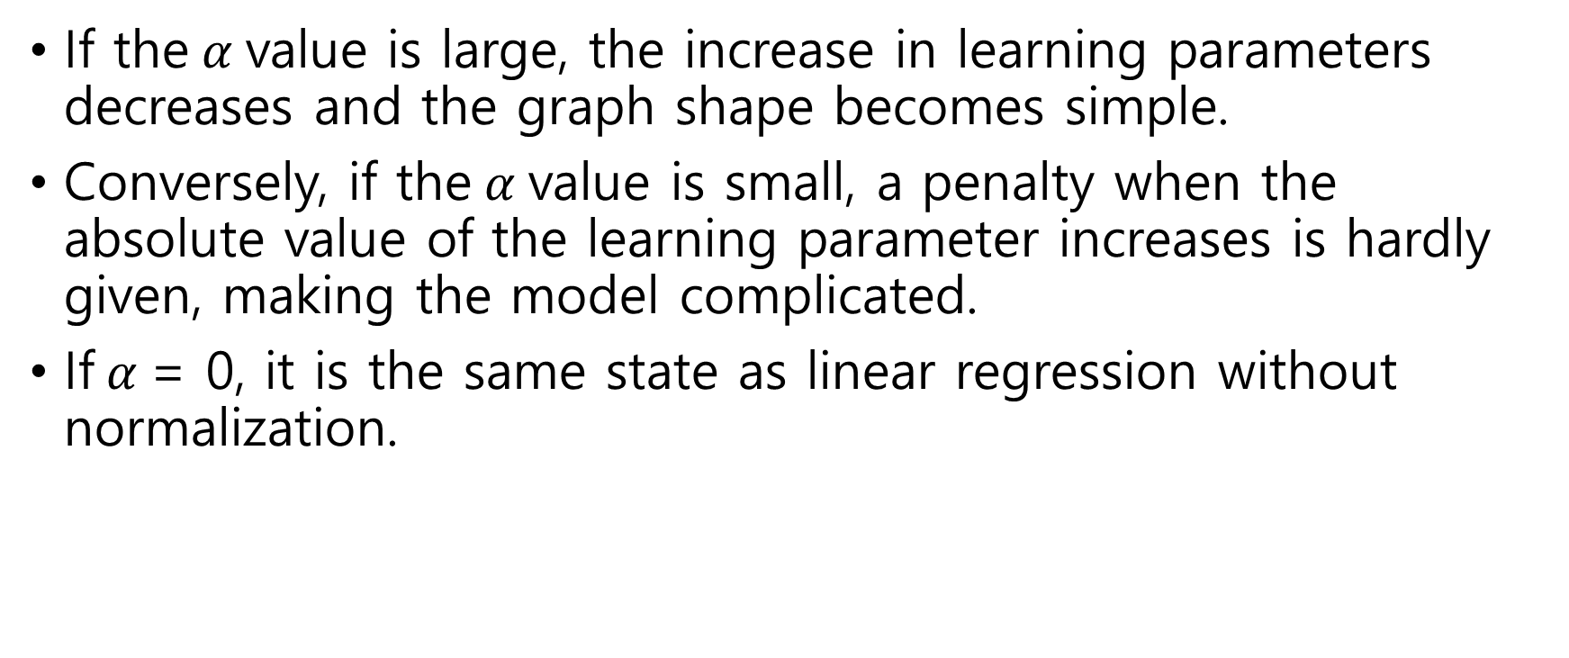
Adjust normalization strength with$α$
If the$α$value is large, the increase in learning parameters decreases and the graph shape becomes simple.
Conversely, if the$α$value is small, a penalty when the absolute value of the learning parameter increases is hardly given, making the model complicated.
If$α$= 0, it is the same state as linear regression without normalization.

Slide 23
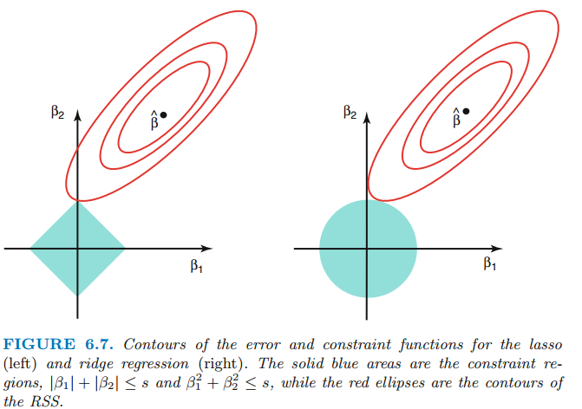
LASSO regression
In ridge regression, the graph is circular as shown in the right picture because the penalty term is the sum of the learning parameters squared.
In LASSO regression, the penalty term is the sum of the absolute values, so the graph is square as shown in the figure on the right.

Slide 24
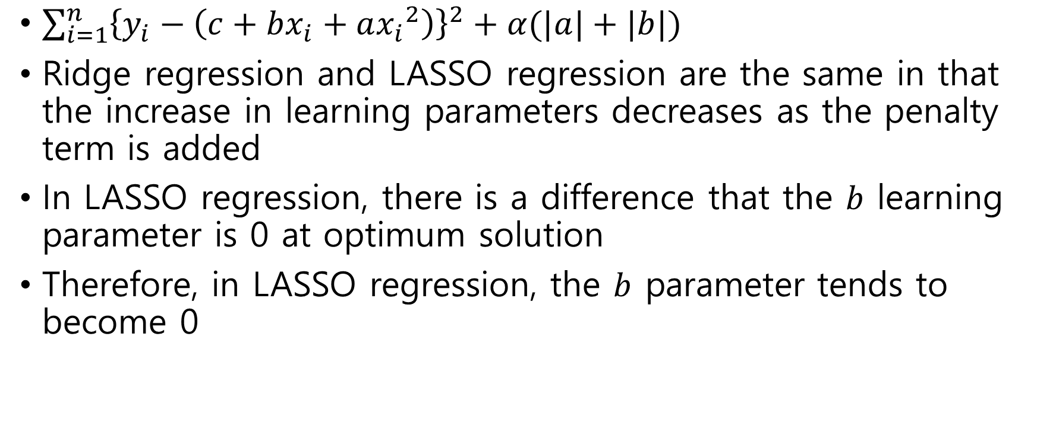
LASSO regression
$\sum_{i=1}^{n}{{\left\{y_{i}−\left(c+bx_{i}+a{x_{i}}^{2}\right)\right\}}^{2}}+α(|a|+|b|)$
Ridge regression and LASSO regression are the same in that the increase in learning parameters decreases as the penalty term is added
In LASSO regression, there is a difference that the $b$ learning parameter is 0 at optimum solution
Therefore, in LASSO regression, the $b$ parameter tends to become 0

Slide 25
Supervised Learning
Logistic Regression
경희대학교 컴퓨터공학과
2019102191 신주영

Slide 26
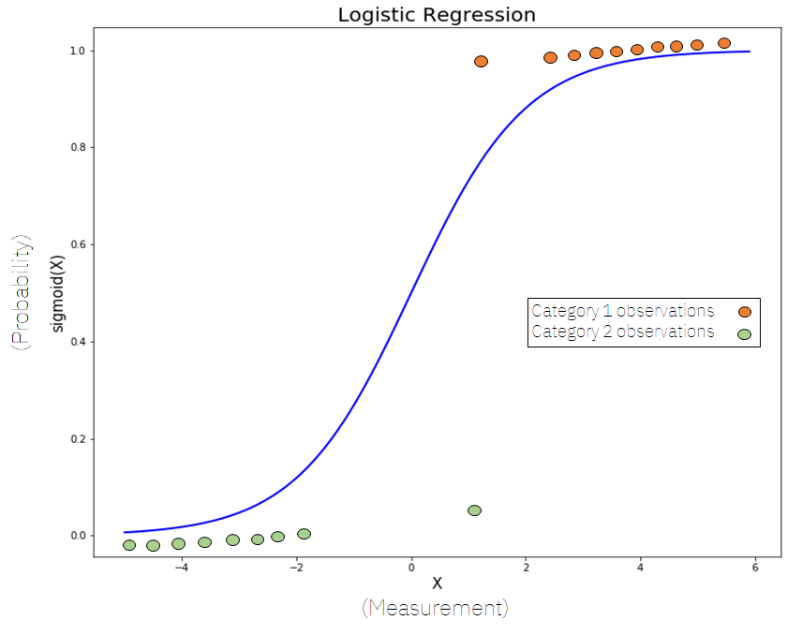
Fundamental Concept

Slide 27
Fundamental Concept
Logistic regression is an algorithm that learns the probability of an event occurring
Usually, binary classification is performed, but more than three classification problems can also be dealt with

Slide 28
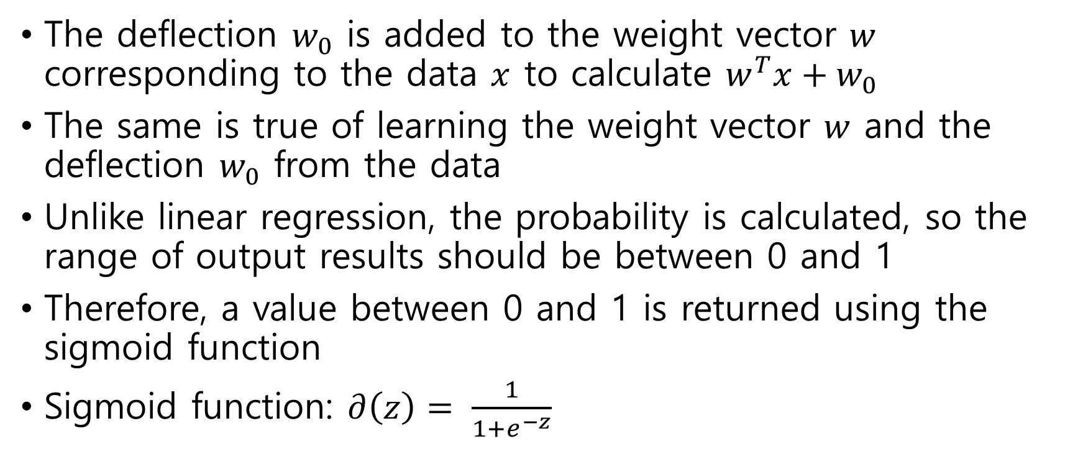
Algorithm
The deflection $w_{0}$ is added to the weight vector $w$ corresponding to the data $x$ to calculate $w^{T}x+w_{0}$
The same is true of learning the weight vector $w$ and the deflection $w_{0}$ from the data
Unlike linear regression, the probability is calculated, so the range of output results should be between 0 and 1
Therefore, a value between 0 and 1 is returned using the sigmoid function
Sigmoid function: $∂\left(z\right)= \frac{1}{1+e^{−z}}$

Slide 29
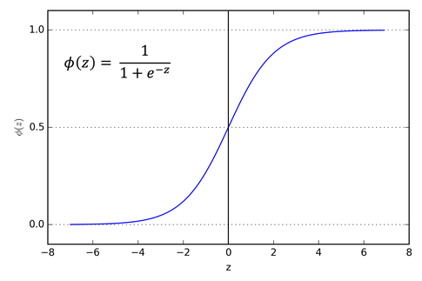
Algorithm sigmoid function graph

Slide 30
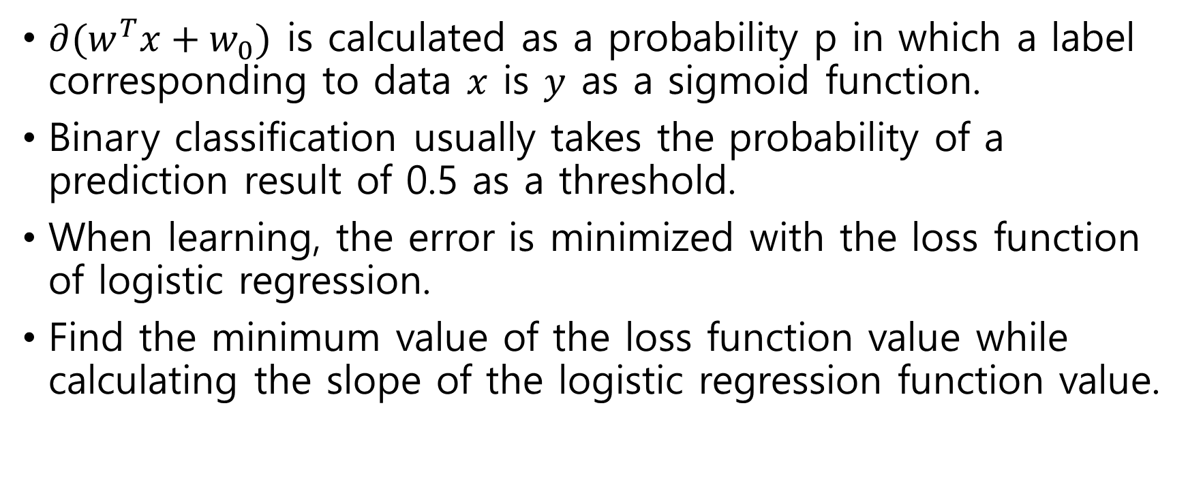
Algorithm
$∂{(w}^{T}x+w_{0})$ is calculated as a probability p in which a label corresponding to data $x$ is $y$ as a sigmoid function.
Binary classification usually takes the probability of a prediction result of 0.5 as a threshold.
When learning, the error is minimized with the loss function of logistic regression.
Find the minimum value of the loss function value while calculating the slope of the logistic regression function value.

Slide 31
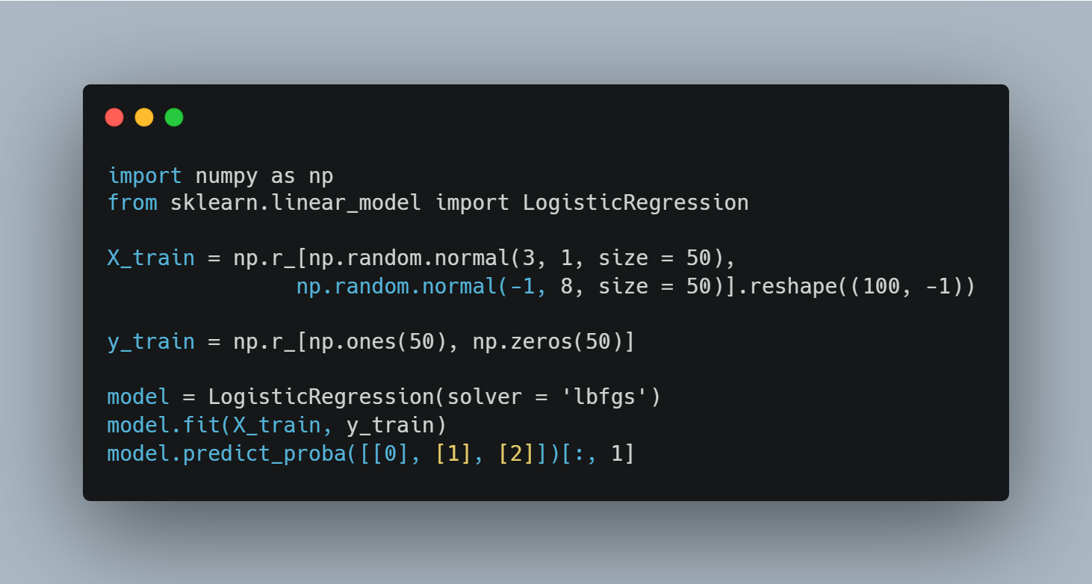
Sample Code random number example
Import numpy and sklearn
Make feature data
Make label data
generation and learning and prediction of logistic regression models

Slide 32
About solvers
For small datasets, ‘liblinear’ is a good choice, where as ‘sag’ and ‘sega’ are faster for large ones.
For multiclass problems, only ‘newton-cg’, ‘sag’, ‘sega’ and ‘lbfgs’ handle multinomial loss.
‘liblinear’ is limited to one-versus-rest schemes.

Slide 33
About solvers
 | Newton-cg | Lbfgs | Liblinear | Sag | Sega
Penalty term | ‘L2’, ‘none’ | ‘L2’, ‘none’ | ‘L1’, ‘L2’ | ‘L2’, ‘none’ | ‘elasticnet’, ‘L1’, ‘L2’, ‘none’
Dataset size | Does not care | Does not care | Small dataset | Fast at large dataset | Fast at large dataset
class | Multi class Problem | Multi class Problem | Only class Problem | Multi class Problem | Multiclass problem

Slide 34
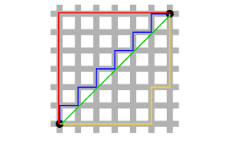

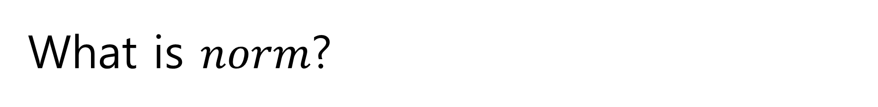
What is $norm$?
It is norm that the vector tells how large it is.
norm is a function that sends a set of real numbers $ℝ$ in a vector space called $V$.

Slide 35

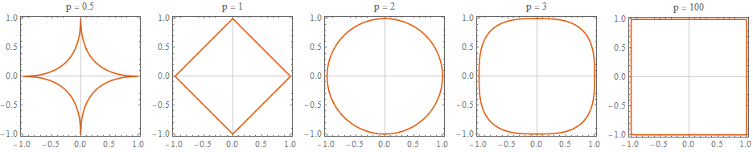
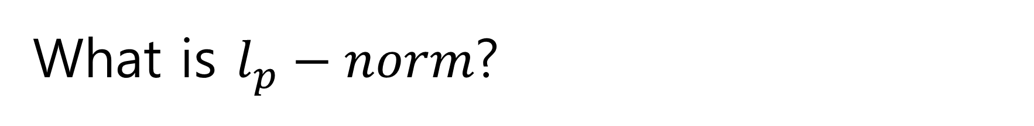
What is $l_{p}−norm$?

Slide 36
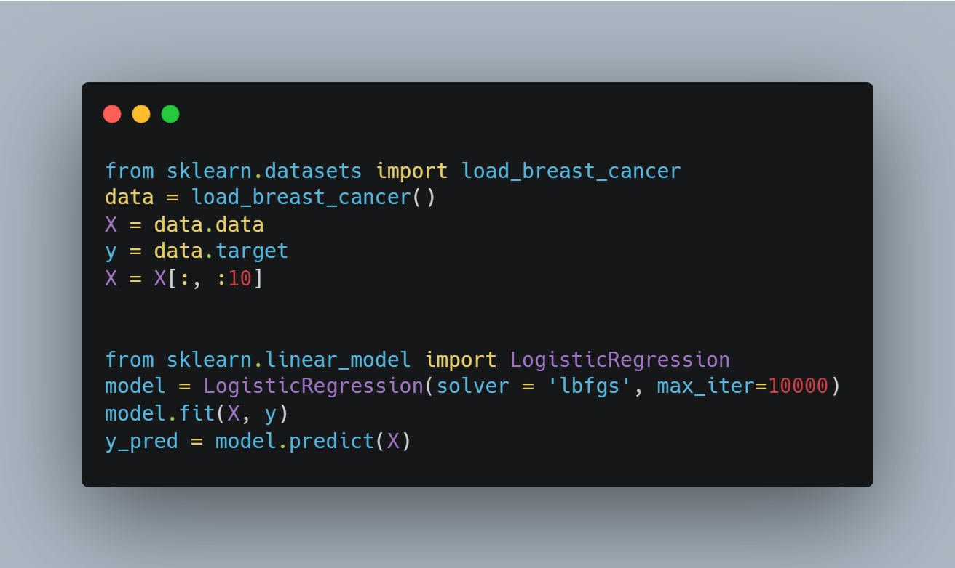
Sample code breast cancer dataset example
Load dataset
Get only the data we want
Import logistic regression library
Make logistic regression instance
Predict the result

Slide 37
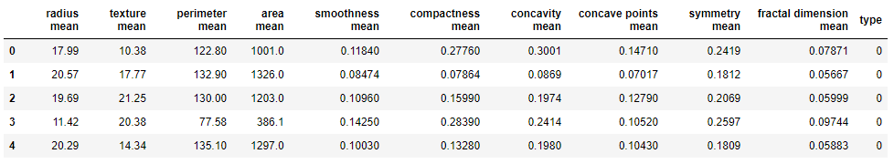
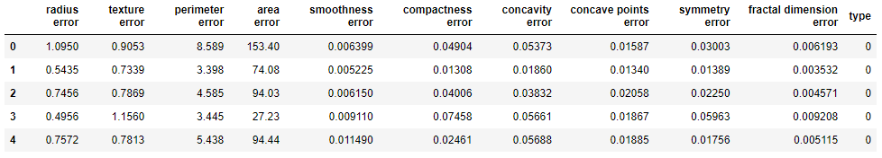
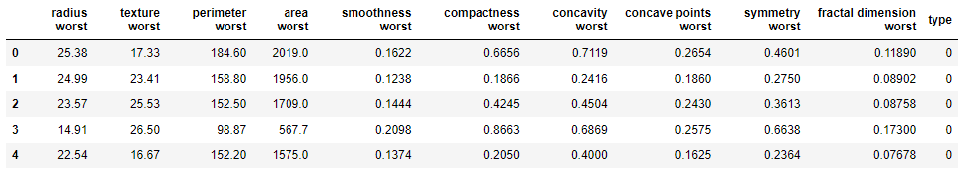


Breast cancer diagnosis dataset table

Slide 38
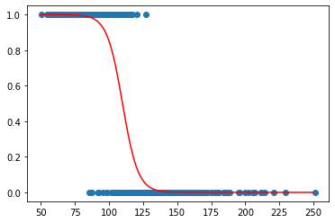
Only the perimeter worst value visualization
TP
FN
FP
TN

Slide 39
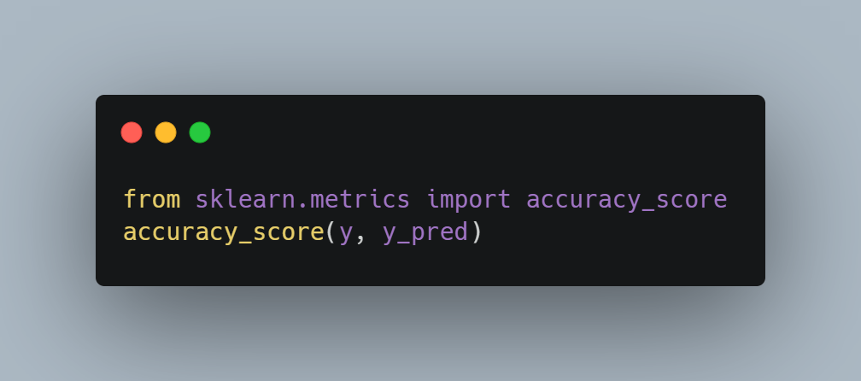
Accuracy variation according to dataset
Only the average: 0.9121
Only the error: 0.8928
Only the worst: 0.9561
All of them: 0.9578

Slide 40
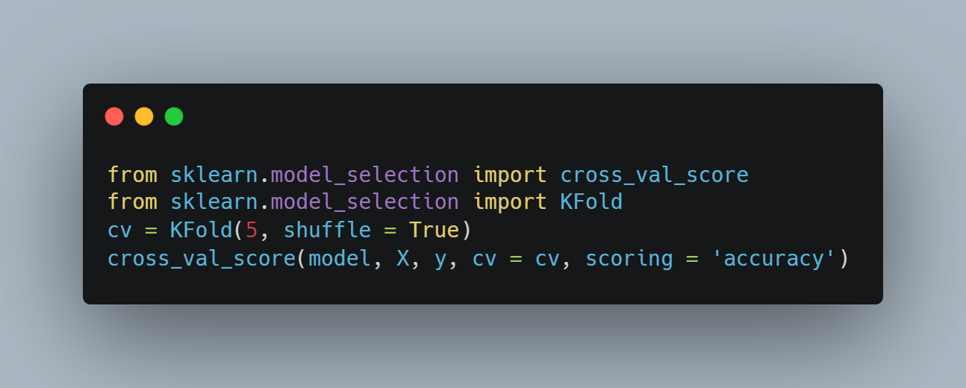
Cross Validation according to dataset
Only the average
Only the error
Only the worst
All of them

Slide 41
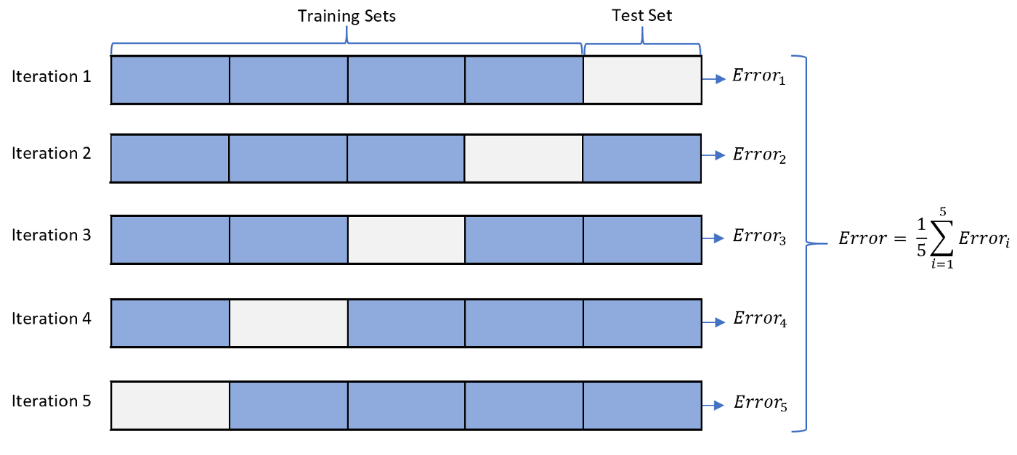
Ways to prevent over-fitting
Cross Validation

Slide 42
Determination boundary
When unknown data is put into the model trained to solve the classification problem and classified, the classification result changes to a boundary of some data.
The boundary in which the classification results change is called the determination boundary.
In logistic regression, the decision boundary is where the result of calculated probability is 50%.

Slide 43
Supervised Learning
SVM (Support Vector Machine)
경희대학교 컴퓨터공학과
2019102191 신주영

Slide 44
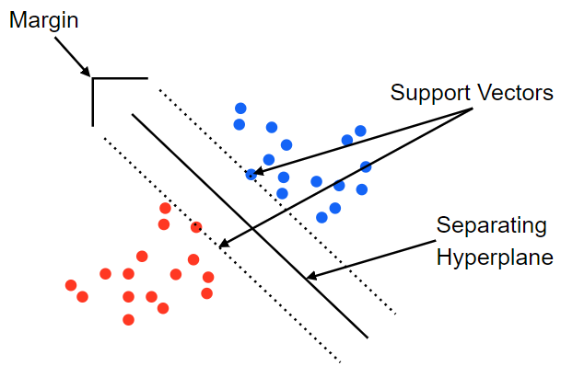
Fundamental Concept
The decision boundaries obtained by SVM maximize margin between groups, so learn to have no points belonging to the boundaries and classify them more clearly than logistic regression.

Slide 45
Algorithm
SVM deals with the problem of binary classification of planes assuming linear and complete classification is possible.
Maximize the margin between groups to obtain a good decision boundary to classify.

Slide 46
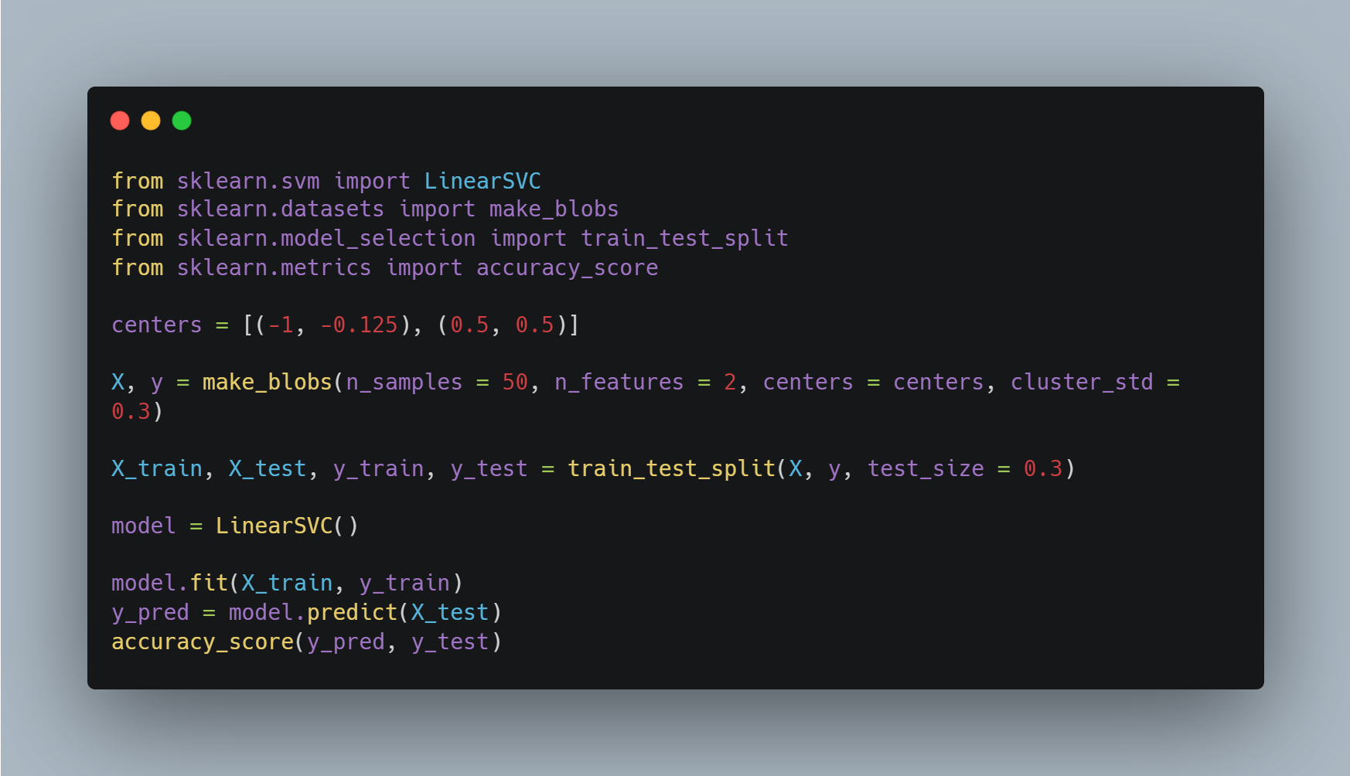
Sample Code
Import libraries
Set center coordinate of data
Make random numbers based on center coordinate
Make SVM model
Learning data
Get accuracy

Slide 47
Margin and Support vector
If the margin does not contain data, it is called hard margin.
Allowing some data to be contained in margin is called soft margin.
Learning data is divided into three categories.
  data outside margin: data outside the margin based on the decision boundary
  margin data: data for determining margin based on decision boundaries
  data inside margin: data that are in margin or misclassified based on the boundary of the boundaries

Slide 48
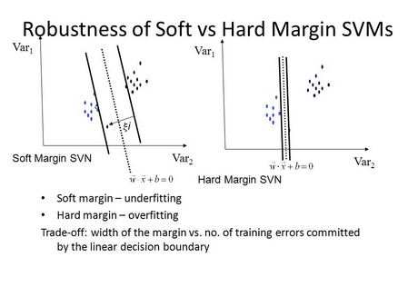
Hard margin and Soft margin
The left graph using soft margin is not affected by the fact that the learning results are far away.
The graph on the right using hard margin is greatly influenced by the point far away.
How much data in the margin is allowed in soft margin follows the hyperparameters set by the person himself.

Slide 49
Supervised Learning
SVM(Support Vector Machine) Using Kernel
경희대학교 컴퓨터공학과
2019102191 신주영

Slide 50
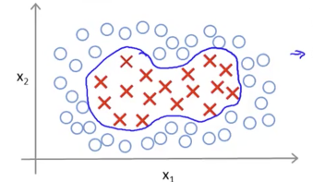
Fundamental Concept
In SVM, it is difficult to classify data in which the boundary of each label is curved because the decision boundary is a straight line.
Complex decision boundaries can be learned by applying kernel techniques to SVM.

Slide 51
Algorithm
Kernel technique: linear regression after transferring data to another feature space
Conditions required to allow linear separation of data that cannot be linearly separated
  There is a higher dimension space than the learning data, and each point of the learning data corresponds to a point of the higher dimension space.
  Points corresponding to learning data in a high-dimensional space can be linearly separated, and actual learning data is projection in a high-dimensional space.

Slide 52
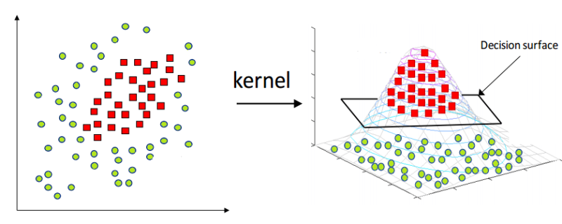
Algorithm

Slide 53
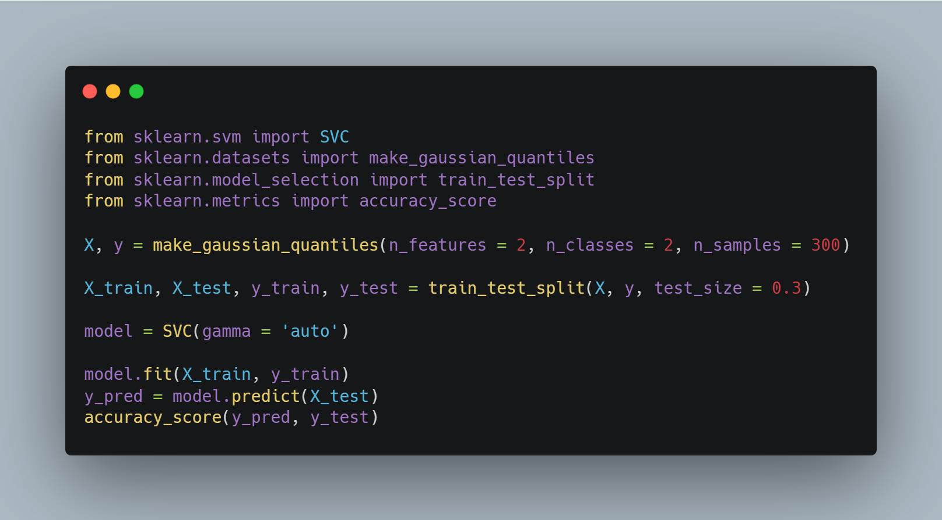
Sample Code
Import libraries
Make gaussian quantiles
Set train, test dataset
Make SVM model
Learn and predict data
Check accuracy

Slide 54
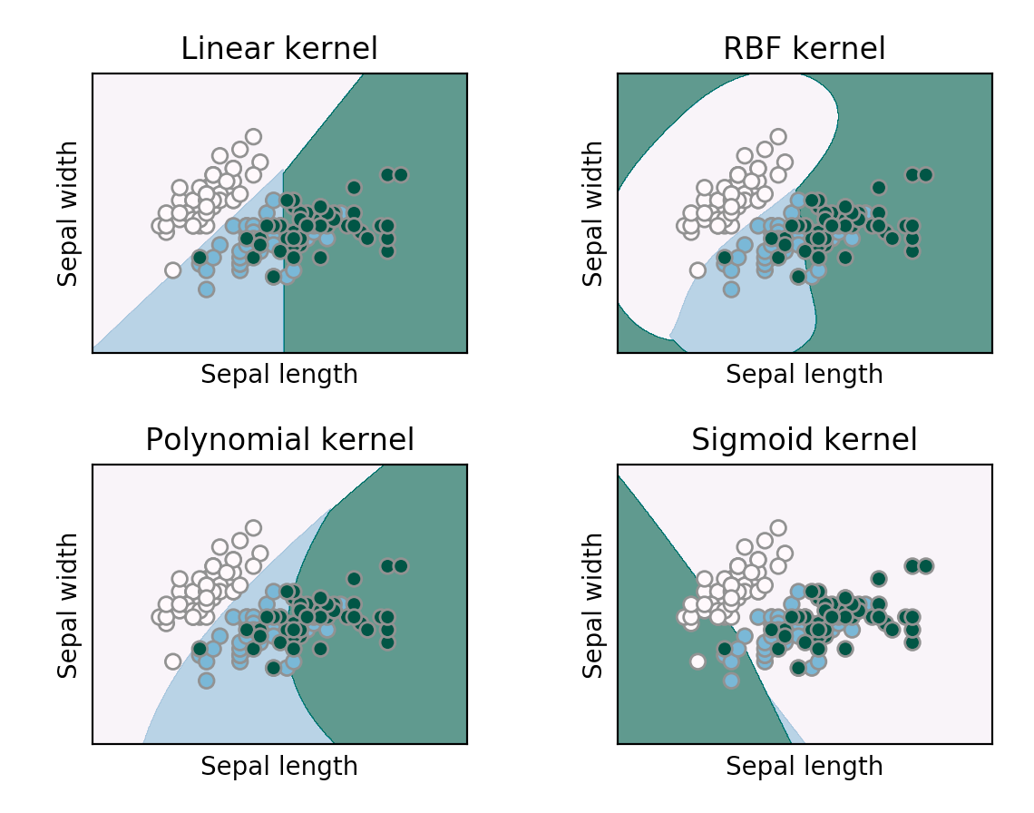
Difference in learning outcomes using kernel functions

Slide 55
Points to note
The larger the hyperparameter value, the more complex the decision boundary is learned from the data.
Kernel techniques are recommended to be used to require accuracy rather than feature analysis.
It should be noted that meaningful decision boundaries are not obtained as a result of learning.

Slide 56
Supervised Learning
Naïve Bayes Classification
경희대학교 컴퓨터공학과
2019102191 신주영

Slide 57
Fundamental Concept
The Naïve Bayes Classification is one of the algorithms for predicting results based on probability.
Calculate the probability of which label the data belongs and classify the data into the label with the highest probability.
We’re going to use The Naïve Bayes classification going to be used to classify virtual news article titles into ‘영화' and ‘우주'.
학습 데이터 | 카테고리
감동을 준 명작 영화가 부활 | 영화
화려한 액션 영화가 개봉 | 영화
명작의 부활에 세계가 감동 | 영화
모래 폭풍이 화성을 덮다 | 우주
마침내 화성 탐사 재개 | 우주
VR로 보는 화성의 모래 폭풍과 감동 | 우주
검정 데이터 | 카테고리
부활한 명작에서 보여주는 액션에 감동 | ??

Slide 58
Fundamental Concept
According to the table, there are three categories of articles in the learning data, one for 영화 and one for 우주.
Simply put, there is a 50 % chance that a title is a movie or a universe.
We will take an example by paying attention to the word ＇감동' included in the test data.

Slide 59
Fundamental Concept
학습 데이터
기사제목 6개
영화 카테고리
3개
우주 카테고리
3개
없음
1개
있음
2개
없음
2개
있음
1개
카테고리 | ‘감동’이 나타날 조건부 확률
영화 | 2/3
우주 | 1/3

Slide 60
Algorithm
Data Preprocessing
When dealing with the classification problem of natural language processing into the Naïve Bayes classification, input data must be converted into a vector composed of features.
The preprocessing in this example is to convert the article title to BoW (Bag of Words) and then create a vector consisting of feature and label pairs.

Slide 61
Algorithm
Data Preprocessing
First, only nouns are extracted from the article title of the learning data. At this time, the word order is ignored and treated as a set.
학습데이터 | 카테고리
{“감동”, “명작“, “영화“} | 영화
{“화려”, “액션”, “영화“} | 영화
{“명작”, “세계“, “감동“} | 영화
{“모래 폭풍“, “화성”} | 우주
{“화성”, “탐사“, “재개“} | 우주
{“VR”, “탐사”, “재개”} | 우주

Slide 62
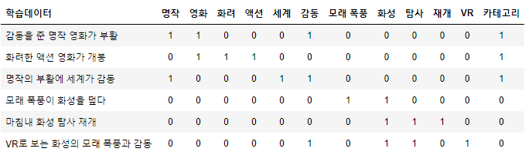
Algorithm
Data Preprocessing
Second, Change the word set and category of the feature to be easy to handle.
When the learning data includes words in a set of words, add 1 and 0 when not included.
As shown in the table above, a pair of features and labels is called BoW depending on whether there is a word in a natural language sentence.

Slide 63
Algorithm
Data Preprocessing
Third, The test data is also converted to BoW.

Slide 64
Algorithm
Calculate Probability
When learning by the Naïve Bayes classification, two types of probabilities are calculated.
  a. probability of each label appearing
  b. conditional probability of each word appearing on each label
  calculate $a×b$
The part allocated 0.01 is the part allocated with the original probability 0, which means that the word is not in the learning data.
 | 명작 | 영화 | … | 감동 | … | VR
영화 | 2/3 | 2/3 | … | 2/3 | … | 0.01

Slide 65
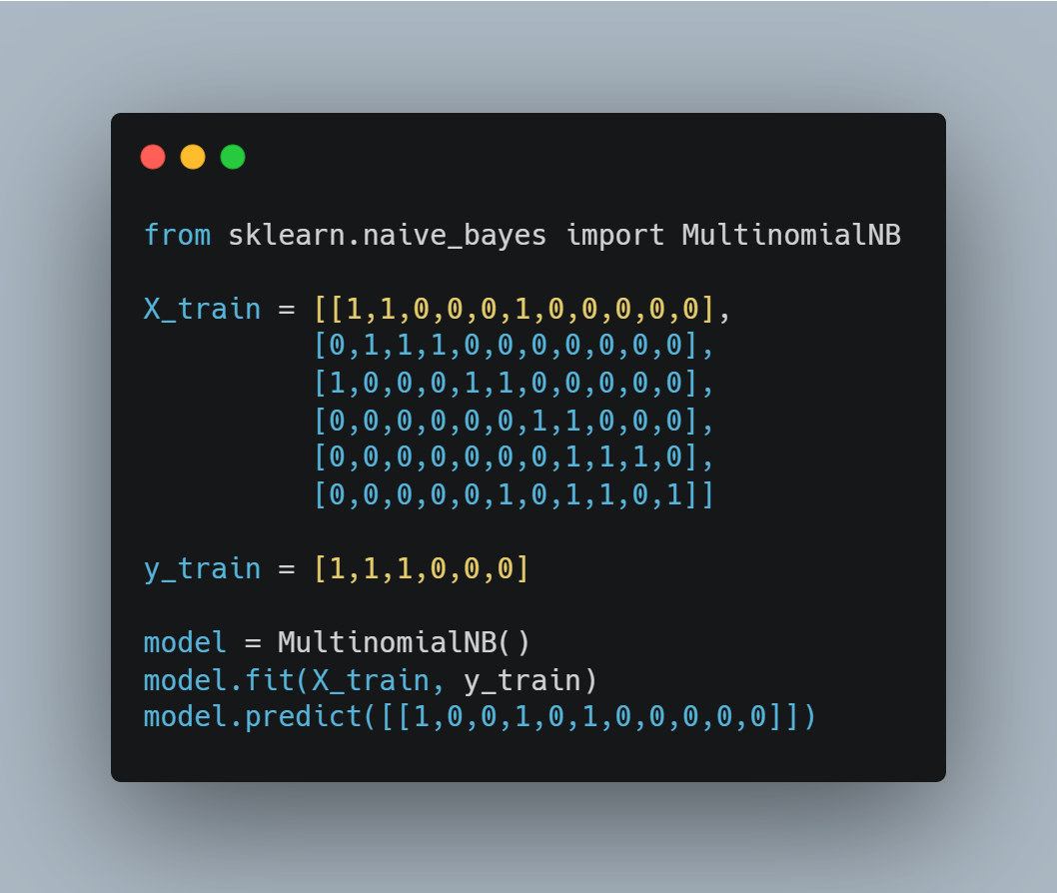
Sample Code
Import libraries
Make X, y data
Make model and training
Predict result

Slide 66
Supervised Learning
Random Forest
경희대학교 컴퓨터공학과
2019102191 신주영

Slide 67
Fundamental Concept
Random forest is a method of combining various models to create a high-performance model.
It can be used for both regression and classification problems.
Similar algorithms include gradient boosting.
Random forest uses multiple models called decision trees to increase accuracy than using a single decision tree.
Random forest is used for both classification and regression problems, but this section exemplifies the classification problem.

Slide 68
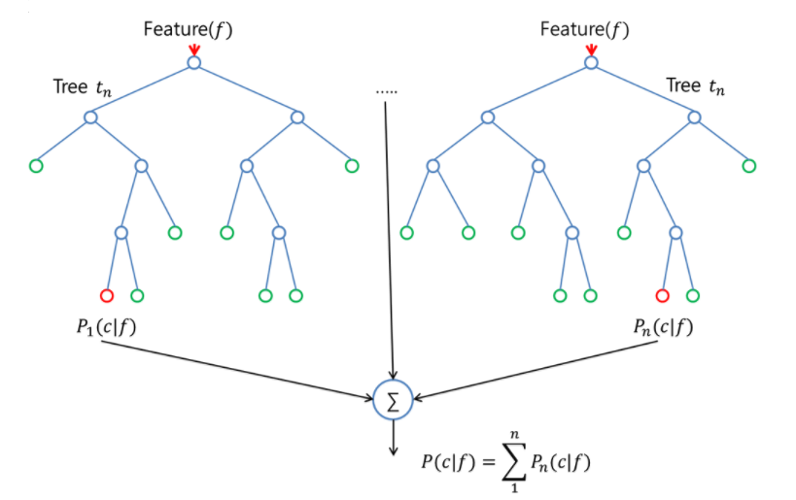
Fundamental Concept
The most predictive results are obtained as the final classification result by collecting the predictive results from each decision tree.
Random forest should be different for each decision tree.

Slide 69
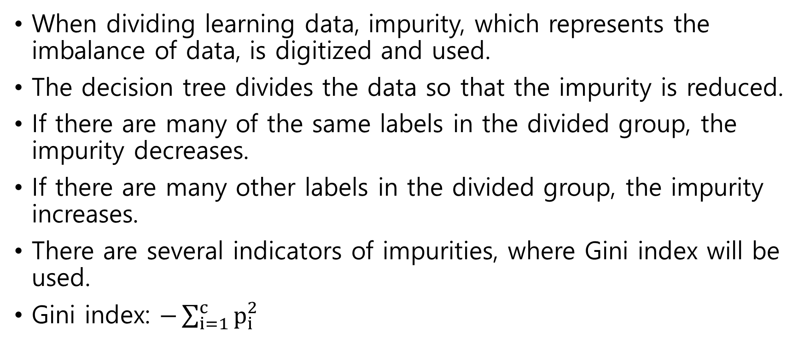
Algorithm
Decision Tree
When dividing learning data, impurity, which represents the imbalance of data, is digitized and used.
The decision tree divides the data so that the impurity is reduced.
If there are many of the same labels in the divided group, the impurity decreases.
If there are many other labels in the divided group, the impurity increases.
There are several indicators of impurities, where Gini index will be used.
Gini index: $−\sum_{i=1}^{c}{p_{i}^{2}}$

Slide 70
Algorithm
Decision Tree
In this case, $c$ is the number of labels and $p_{i}$ is the number of labels divided by the number of data.
The Gini coefficient and the weighted average using it are calculated according to the method of dividing the data.
  Calculate all features of one area and the impurity of the object to be divided
  Divide areas to minimize impurities.
  After dividing, repeat 1~2 steps in each area.

Slide 71
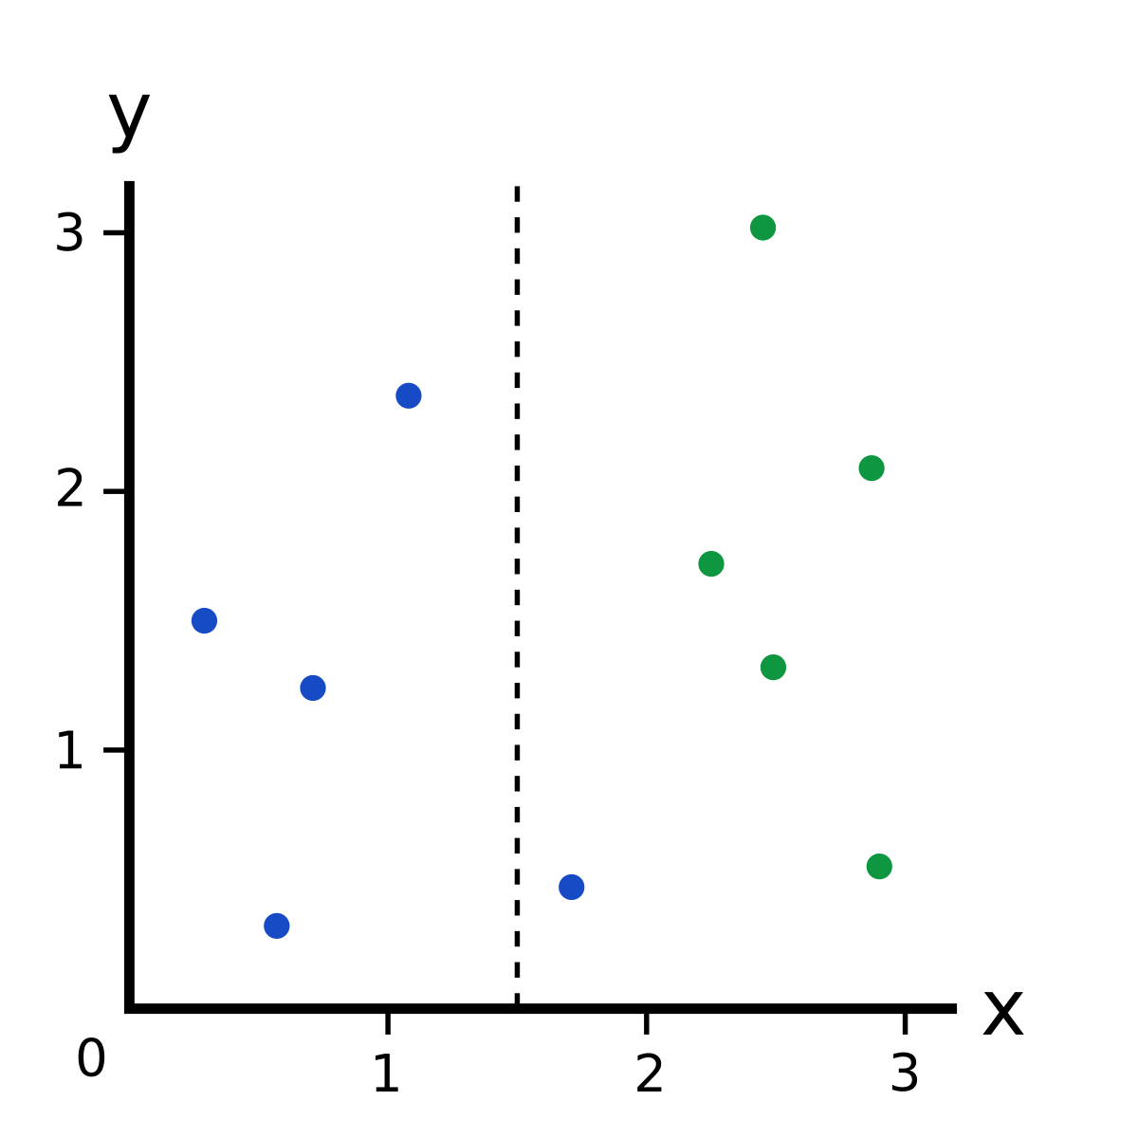
Algorithm
Decision Tree

Slide 72
Algorithm random forest
Bootstrap: A method of "increasing" learning data by performing random recovery extractions from learning data several times. In one learning data, several learning data with different contents are generated and the learning data placed in each decision tree is different.
Certain optional choices: Choose and use only a few features randomly when learning the decision tree with bootstrap learning data.
Random forest learns to have different classification results using the above method.

Slide 73
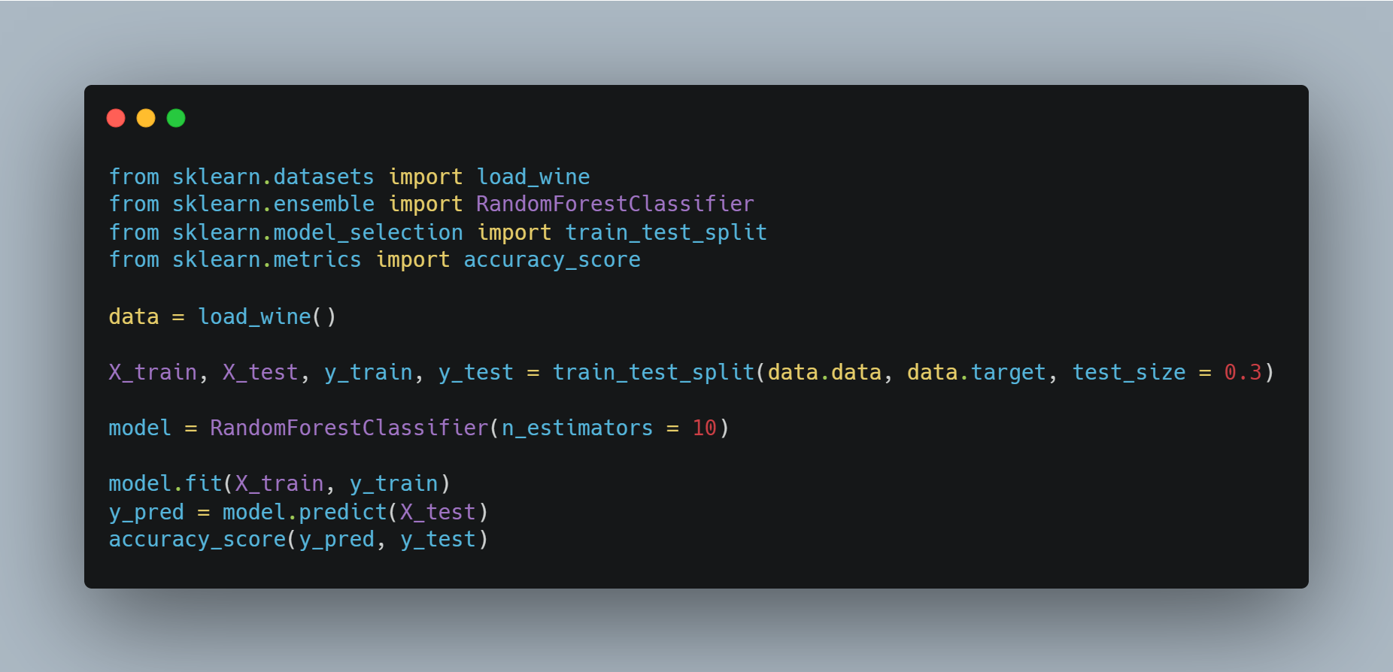
Sample Code
Import libraries
Make dataset
Set train and test data
Make Random Forest model
Train data into model
Calculate accuracy

Slide 74
Importance of feature
Feature of high importance are expected to significantly reduce impurities by using them as criteria for dividing areas.
The feature of low importance is that it is difficult to reduce impurities even when used as a criterion for dividing areas.
In this way, attention should be paid to the importance of features and unnecessary features should be reduced.

Slide 75
Supervised Learning
Neural Network
경희대학교 컴퓨터공학과
2019102191 신주영

Slide 76
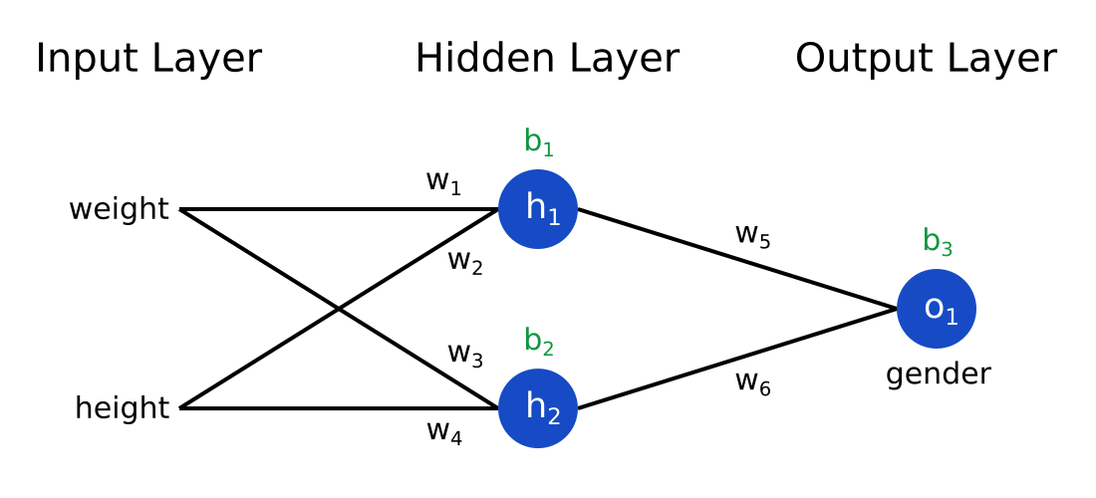
Fundamental Concept
A neural network is a model that learns complex decision lines by defining a hidden layer between the input layer and the output layer
It can be applied to both regression and classification, but it is mainly applied to classification problems.
The above figure is a neural network in which the input layer is 2D, the hidden layer is 2D, and the output layer is 1D.

Slide 77
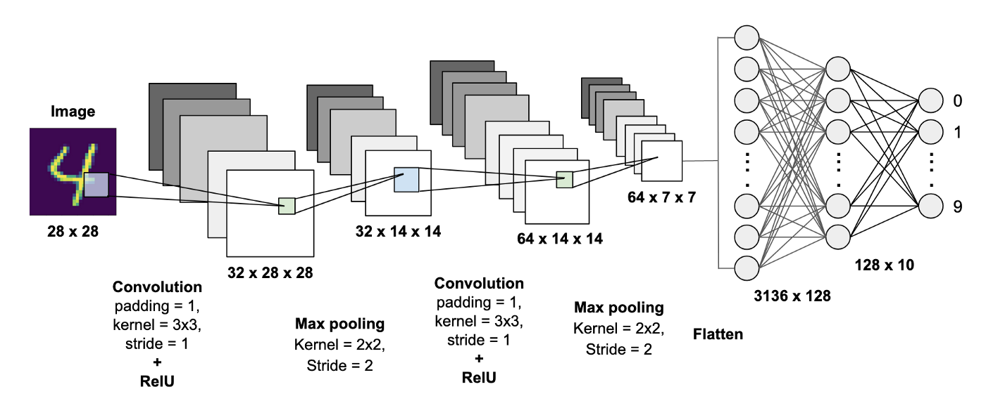
Fundamental Concept

Slide 78
Algorithm fault perceptron
After applying a neural network to classifying NIST, a dataset composed of cursive letters, we will check the classification results.
NIST has 10 cursive letters ranging from 0 to 9.
The input layer represents the input cursive numeric image itself.
The pixel values of each point are stored in a 1D column vector.
The hidden layer calculates a value received from the input layer with a nonlinear function such as a sigmoid function.
The larger the hyperparameters, the more complex decision lines are learned, but overfitting is likely to occur.
The output layer also calculates the value received from the hidden layer as a nonlinear function.
The output layer outputs 10 probabilities that the input cursive numerical image belongs to one of 0 to 9.

Slide 79
Algorithm fault perceptron
A fault perceptron is a model that identifies data by applying a nonlinear function to a result obtained by multiplying a feature by a weight.
For example, if feature is 2D, input feature is ($x_{1}$, $x_{2}$).
$y=f(w_{0}+w_{1}x_{1}+w_{2}x_{2})$
we call $w_{1}$, $w_{2}$ as a weight, $w_{0}$ as a bias.
Weight and bias are parameters used for learning.
non-linear function f is called activation function
The probability y is calculated using the sum of the weights and features. In this case, the activation function uses a sigmoid function or the like.

Slide 80
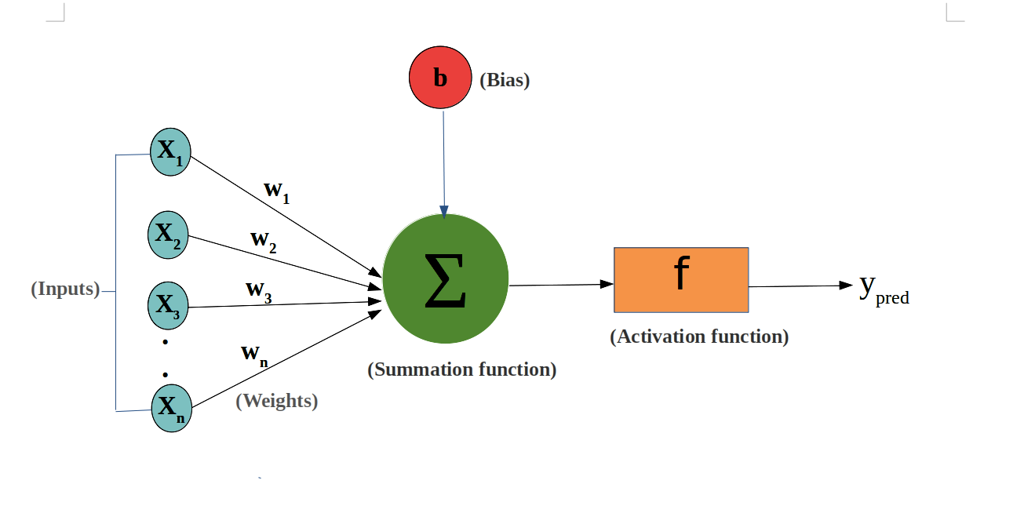
Algorithm fault perceptron

Slide 81
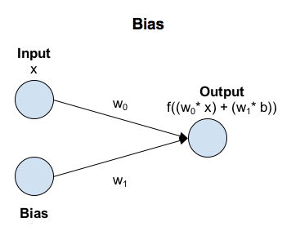
Algorithm fault perceptron
It also simply shows only the input and output parts.
Fault perceptron have similar characteristics to logistic regression.
If activation function $f$ is only sigmoid function, fault perception is same as logistic regression

Slide 82
Algorithm
Neural Network
A neural network is a model that defines several fault perceptron to represent complex decision line.
fault perceptron can't learn decision line correctly.
Set a hidden layer between the input and output.
Set the decision to make the final decision by combining the output results of the two layers.

Slide 83
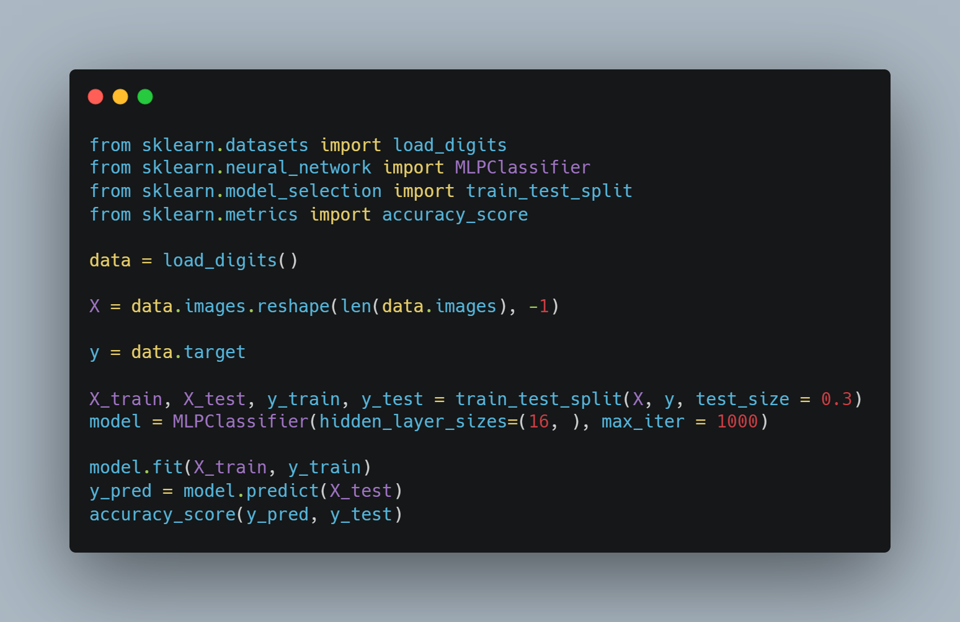
Sample Code
Import libraries
Load data
Reshape images
Set label data
Set training, test data
put training data to model
Predict result
Check accuracy

Slide 84
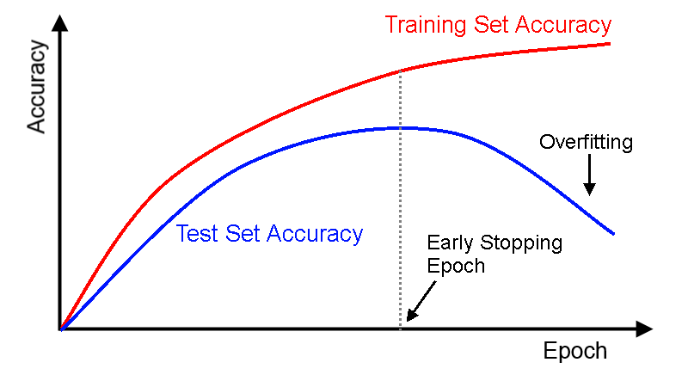
Early stopping
Some of the learning data is further divided into evaluation data used during learning.
It stores evaluation indicators such as loss in order with evaluation data used during learning so that the degree of learning progress can be known.
If there are signs of overfitting during learning, the learning is terminated in the middle.

Slide 85
Supervised Learning
kNN (k-Nearest Neighbors Algorithm)
경희대학교 컴퓨터공학과
2019102191 신주영

Slide 86
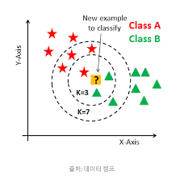
Fundamental Concept
kNN can be applied to both classification and regression problems.
When classifying unknown data, the distance to the learning data is calculated to determine how the data is classified up to k points nearby, and then the data is classified by majority vote 2.

Slide 87
Algorithm
calculating the distance of learning data from input data
Search for k learning data close to input data
Categorize input data that is not known by majority vote in the label of learning data.

Slide 88

Sample Code
Import libraries
Make sample data
Set training, test data
Train data
Predict result
Calculate accuracy

Slide 89
Difference in decision boundary according to k value
The smaller the k value, the more likely over-fitting occurs.
Conversely, if the value of k is too large, the decision boundary cannot be accurately learned.

Slide 90
Points to note
The kNN is basically not suitable for large amounts of data processing.
High-level data is difficult to learn. This is because asymptotic assumptions of the kNN algorithm are not necessarily established in high-dimensional data.

